Slide 1

AI-Powered Interactive Learning Assistant for Classrooms
INTERNSHIP 2
Nadeem Khan BU22CSEN0300262
P Suparna Chandra BU22CSEN0300262
Kamatham Kushal BU22CSEN0300195
Dept of Computer Science & Engineering

Slide 2
Abstract
This project showcases an AI-powered assistant built using the TinyLLaMA language model, optimized with Intel’s OpenVINO toolkit and integrated with a Gradio-based web interface. TinyLLaMA, a lightweight variant of Meta’s LLaMA, enables efficient natural language understanding with minimal computational overhead. The model is converted into OpenVINO’s Intermediate Representation format for fast and low-latency inference on CPUs and integrated GPUs, making it ideal for edge deployment. The user interface, designed with Gradio, supports real-time interaction via both text and voice, with speech input processed using the SpeechRecognition library and Google’s speech-to-text engine. Additional tools like PyAudio ensure cross-platform compatibility. The result is a modular, responsive, and accessible assistant suitable for applications in education, virtual support, and intelligent tutoring—demonstrating how optimized LLMs and user-centric design can bring conversational AI to low-resource environments.
Dept of Computer Science & Engineering

Slide 3
Certificate
Dept of Computer Science & Engineering

Slide 4
Introduction
This project showcases an AI assistant built with the TinyLLaMA language model, optimized using Intel’s OpenVINO and integrated with a Gradio-based interface. TinyLLaMA offers efficient natural language processing with minimal resources, making it ideal for edge deployment. Converted to OpenVINO’s IR format, the model delivers fast, low-latency inference on CPUs and integrated GPUs. The Gradio UI supports real-time text and voice input, with speech processed via Google’s speech-to-text. Tools like PyAudio ensure cross-platform compatibility. The result is a modular, responsive assistant suited for education, virtual support, and intelligent tutoring.
Dept of Computer Science & Engineering

Slide 5
Objectives
The primary objective of this project is to deploy a lightweight large language model, TinyLLaMA, in a highly efficient and interactive manner using the OpenVINO toolkit. This involves converting the original model into an Intermediate Representation (IR) format to enable faster and more resource-efficient inference on CPUs. A secondary goal is to design a modern web-based chatbot interface that supports real-time, token-by-token response streaming, thereby enhancing user experience. Additionally, the project aims to demonstrate how open-source tools like Flask, Transformers, and OpenVINO can be combined to build AI applications that are offline, secure, and suitable for deployment on edge devices or low-spec machines. Through this work, we aim to make advanced language models more accessible and usable in environments where traditional GPU-based solutions are not feasible.
Dept of Computer Science & Engineering

Slide 6
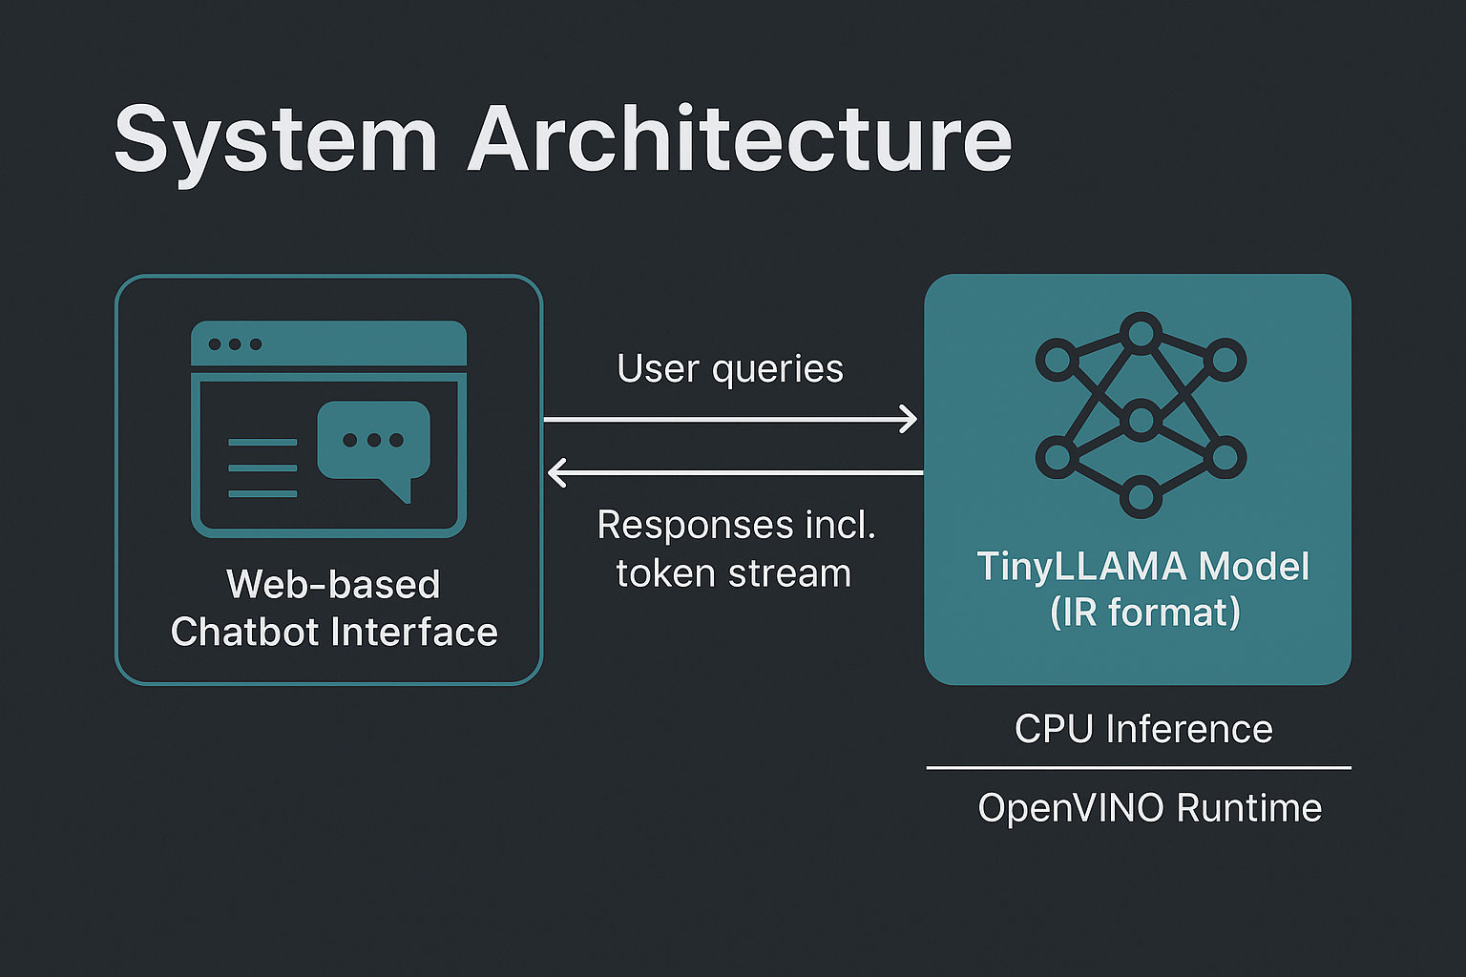
System Architecture
Dept of Computer Science & Engineering

Slide 7
AI Models Used
TinyLLaMA-1.1B-Chat-v1.0 → Lightweight conversational AI model optimized for chat.
HuggingFace Transformers → Provides tokenizer and model conversion utilities.
OpenVINO Runtime → Speeds up inference on CPU using the IR (Intermediate Representation) model.
Optimum ONNX Exporter → Converts the original model into ONNX format compatible with OpenVINO.
Dept of Computer Science & Engineering

Slide 8
Use Cases
🎤 Voice Interaction – Speak your query, get it transcribed and answered.
💻 Offline Assistant – Runs locally on CPU, no internet or GPU required.
📘 Academic Q&A – Ask questions on any topic and get instant answers.
👩‍🏫 Educator’s Aid – Helps teachers generate quick explanations.
💡 Research Ideas – Brainstorm and explore new academic topics.
🧪 Developer Demo – Test LLMs on-device using OpenVINO + TinyLLaMA.
🌍 Language Help – Translate and clarify terms in real time.
🧏 Accessible UI – Designed for both voice and text input for all users.
Dept of Computer Science & Engineering

Slide 9
Future Enhancements
🧠 Add Chat Memory Enable contextual conversations by retaining previous interactions.
🔊 Text-to-Speech (TTS) Respond using synthesized voice for full voice-based interaction.
📲 Mobile-Friendly UI Optimize Gradio interface for tablets and mobile devices.
🔐 User Profiles Introduce login & personalized history for multi-user support.
🗂️ File Upload Support Answer questions from uploaded documents (PDFs, DOCX).
☁️ Hybrid Cloud Mode Option to switch between local and cloud LLMs based on performance needs.
Dept of Computer Science & Engineering

Slide 10
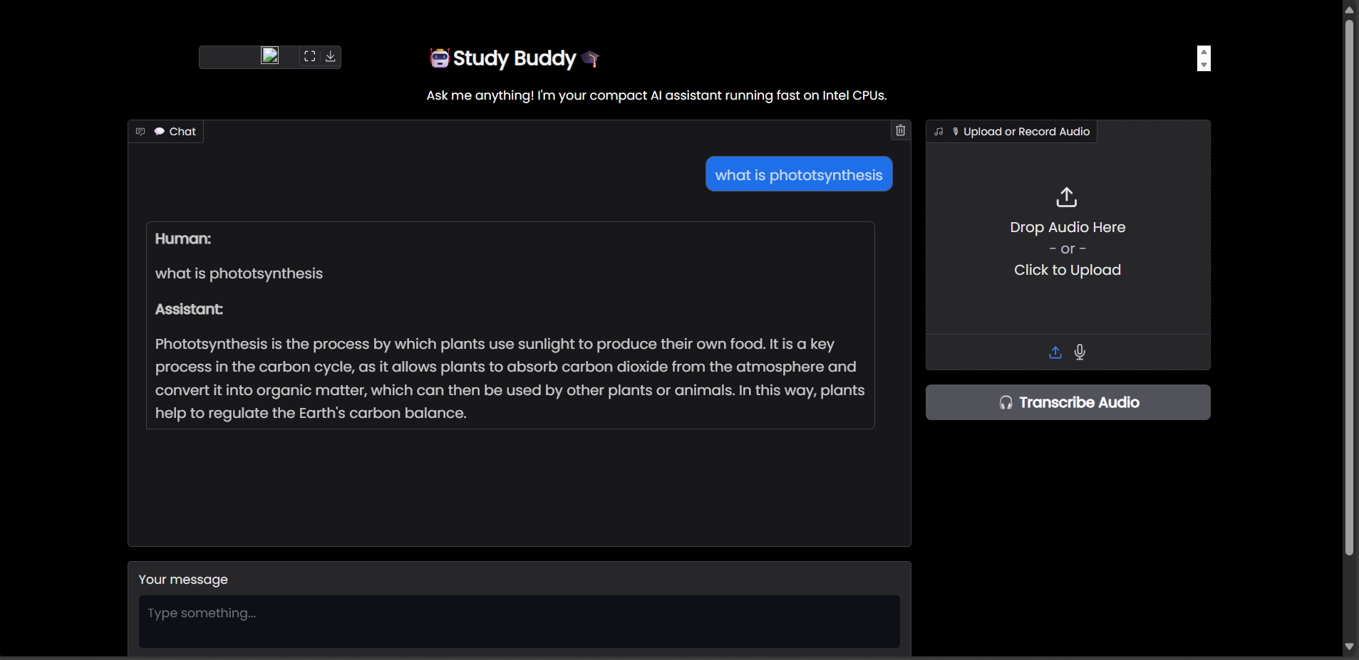
Conclusion
Dept of Computer Science & Engineering

Slide 11
Refrences
TinyLLaMA Model (Hugging Face) https://huggingface.co/TinyLlama/TinyLlama-1.1B-Chat-v1.0
OpenVINO Toolkit (Intel) https://www.intel.com/content/www/us/en/developer/tools/openvino-toolkit/overview.html
Transformers Library (Hugging Face) https://github.com/huggingface/transformers
Gradio UI Framework https://www.gradio.app
SpeechRecognition Library (PyPI) https://pypi.org/project/SpeechRecognition/
Optimum Exporters (ONNX & OpenVINO conversion) https://github.com/huggingface/optimum
Dept of Computer Science & Engineering

Slide 12
Thank You
Dept of Computer Science & Engineering

